Slide 1
机器学习模型的可视分析
ActiVis: Visual Exploration of Industry-Scale Deep Neural Network Models

Slide 2
Introduction
Deep learning models are more difficult to interpret than most existing machine learning models, because they capture nonlinear hidden structures of data using a huge number of parameters.
“black boxes”
Deep learning tasks in industry often involve different types of data, including text and numerical data; however most existing visualization research targets image datasets .
We have identified common analysis strategies to interpret machine learning models.Specifically, we learned that both instance- and subset-based exploration approaches are common and effective.As individual instances are familiar to users, exploring by instances accelerates model understanding. Another effective strategy is to leverage input features or instance subsets specified by users. Slicing results by features helps reveal relationships between data attributes and machine learning algorithms' outputs.

Slide 3
Introduction
Our tool, called ActiVis, aims to support both interpretation strategies for visualization and comparison of multiple instances and subsets.
ActiVis is an interactive visualization system for deep neural network models that
(1) unifies instance-and subset-level inspections,
(2) tightly integrates overview of complex models and localized inspection,
(3) scales to a variety of industry-scale datasets and models.

Slide 4
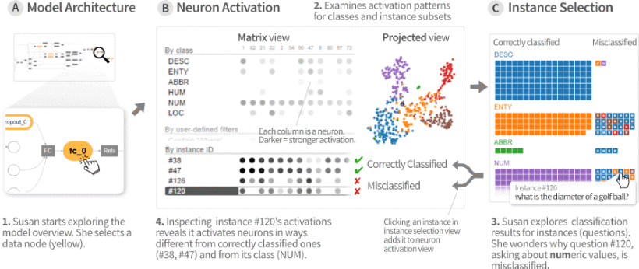
Illustrative Scenario

Slide 5
ActiVis's main contributions include:
A novel visual representation that unifies instance-and subset-level inspections of neuron activations, which facilitates comparison of activation patterns for multiple instances and instance subsets. Users can flexibly specify subsets using input features, labels, or any intermediate outcomes in a machine learning pipeline .
An interface that tightly integrates an overview of graph-structured complex models and local inspection of neuron activations, allowing users to explore the model at different levels of abstraction.
A deployed system scaling to large datasets and models .
Case studies with Facebook engineers and data scientists that highlight how ActiVis helps them with their work, and usage scenarios that describe how ActiVis may work with different models

Slide 6
Machine Learning Interpretation Through Visualization
Instance-Based Exploration: A widely-used approach to understanding complex algorithms is by tracking how an example (i.e., training or test instance) behaves inside the models.
ModelTracker, a visualization tool that shows the distribution of instance scores for binary classification tasks and allows users to examine each instance individually. The researchers from the same group extended their work for multi-classification tasks.
Feature-orSubset-based Exploration: Enables users to better understand the relationships between data and models, as machine learning features make it possible for instances to be grouped and sliced in multiple ways. Researchers have utilized features to visually describe how the models captured the structure of datasets .
The importance weight of each feature in the Naive Bayes algorithm
Partial dependence to show the relationships between features and results.

Slide 7
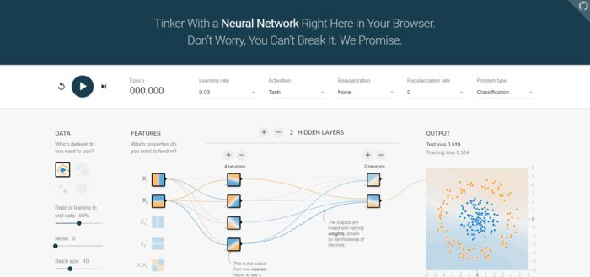
Interactive Visualization of Deep Learning Models
Since deep neural network models typically consist of many parameters, researchers have recognized deep learning interpretation as an important research area. A common approach is to show filters or activations for each neural network layer. This helps users understand what the models have learned in the hidden structure throughout the layers.
PlayGround的网址是：http://playground.tensorflow.org/
PlayGround页面，主要分为DATA（数据），FEATURES（特征），HIDDEN LAYERS（隐含层），OUTPUT（输出层）。它可视化训练参数，以帮助用户探索模型如何处理给定实例以进行预测。
Interactive Visualization Tools
An interactive prototype for educational purposes, called TensorFlow Playground, which visualized training parameters to help users explore how models process a given instance to make predictions.

Slide 8
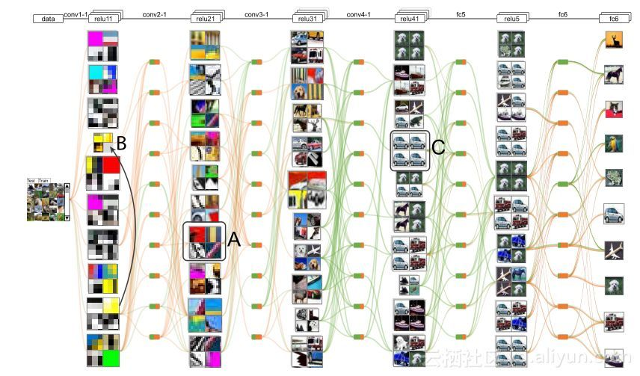
Towards Scalable Visualization Systems
CNNVis is an interactive visual analytics system designed for convolutional networks. It modeled neurons as a directed graph and utilized several techniques to make it scalable.
对于理解和分析深度卷积神经网络而言面临两个技术挑战,首先是CNN由几十或几百的层组成、每层有几千的神经元，其次是CNN是由许多函数分量组成并且其值之间的关系。
因此提出了一个交互式视觉分析系统称CNNVis，可理解分析与改进CNN，提出基于DAG表示，其中每个节点代表一个神经元，每个边代表神经元对之间的连接的混合可视化，另外基于Held-Karp算法设计了矩阵重新排序算法等。

Slide 9
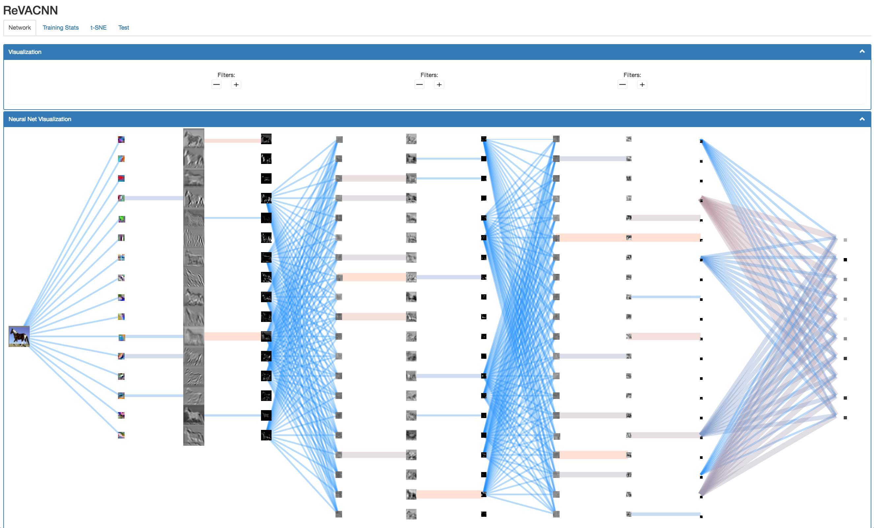
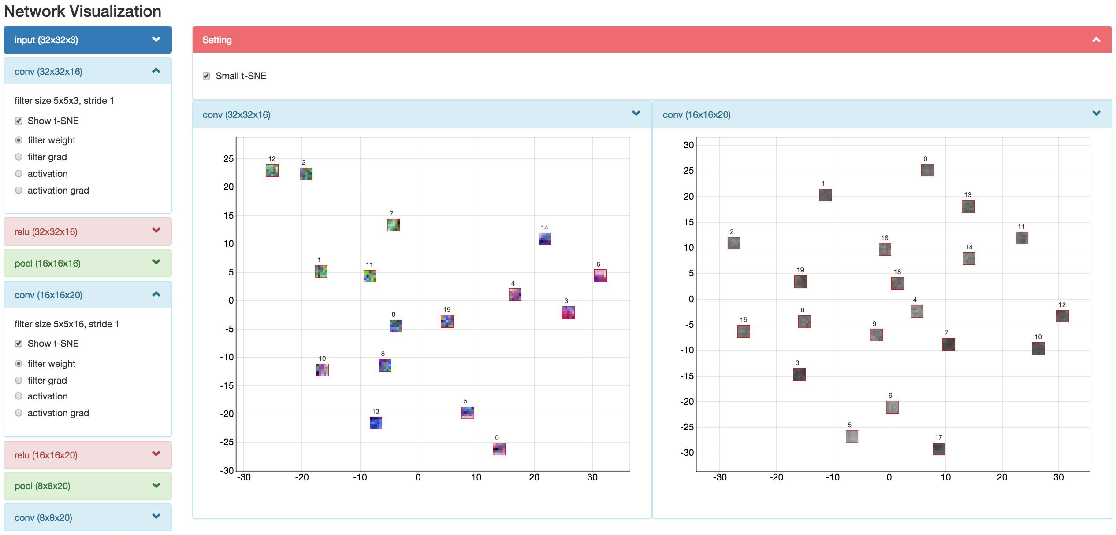
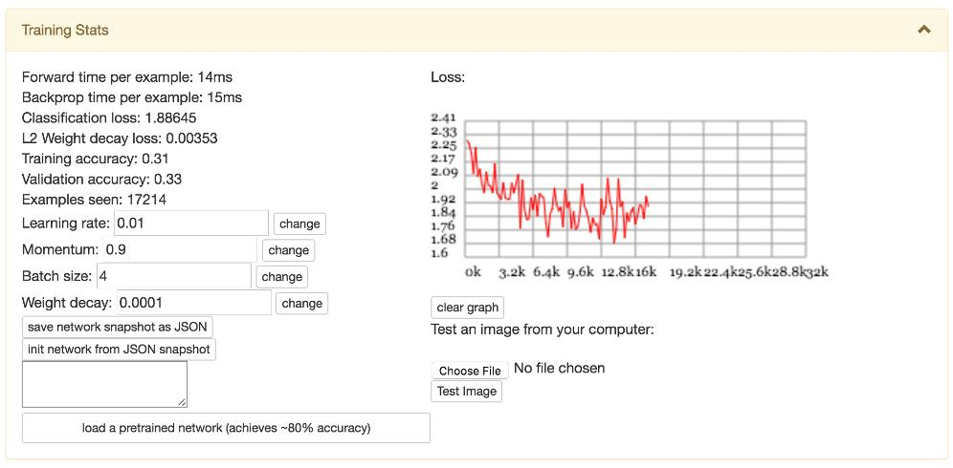
ReVACNN is an interactive visual analytics system that uses dimensionality reduction for convolutional networks.
ReVACNN 将降维用于卷积网络。尽管CNNVis使用聚类处理大量神经元，但ReVACNN既显示单个神经元又显示二维投影嵌入空间（通过t-SNE）。单个神经元视图可帮助用户探索单个神经元如何响应用户选择的实例。投影视图可以帮助获得实例激活的直观摘要。但是，这两个视图是独立工作的。用户很难组合他们的分析或比较多个实例的神经元激活。

Slide 10
Analytics Needs for Industry-Scale Problems
C1. Diverse input sources and formats Data
C2. High data volume Data
C3. Complex model architecture Model
C4. A great variety of models Model
C5. Diverse subset definitions Analytics
C6. Simultaneous need for performing instance-and subset-level analysis Analytics

Slide 11
Design Goals
G1. Unifying instance-and subset-based analysis to facilitate comparison of multiple instance activations.
Both instance-and subset-based analysis are useful and complementary. We aim to support subset-level exploration by enabling users to flexibly define instance subsets for different data types (C1, C5). Subset-based analysis also allows to explore datasets at higher-level abstraction, scaling to billion-scale data or larger (C2). Unify instance-and subset-level inspections to facilitate comparison of multiple instances and groups of instances in a single view (C6).
G2. Tight integration of overview of model architecture and localized inspection of activations.
Industry-scale deep neural network models are often very complex, consisting of many operations (C3). Present the architecture of the models as a starting point of exploration, and switch to the detailed inspection of activations.
G3. Scaling to industry-scale datasets and models through flexible system design.
It is important for the system to be flexible and scalable. We aim to support as many different kinds of data types and classification models (e.g., image, text, numerical) (C1, C4). Addressing visual and computational scalability challenges through a multipronged approach (C2, C3).

Slide 12
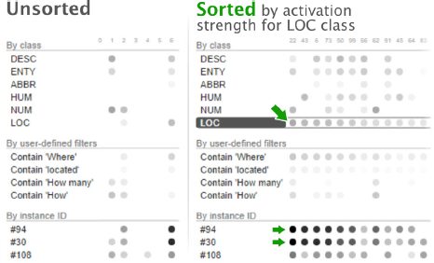
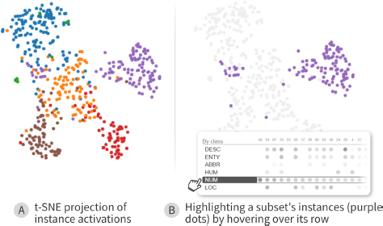
ActiVis
Flexible Subset Definition
A subset can be specified using multiple properties of the instances, in many different ways. Example properties include raw data attributes, labels, features, textual content, output scores, and predicted label.
Sorting to Reveal Patterns
The difficulty in recognizing patterns increases with the number of neurons. ActiVis allows to sort neurons by their activation values.
2-D Projection of Activations
Projection of high-dimensional data into 2-D space is an effective exploration approach. ActiVis performs t-distributed stochastic neighbor embedding (t-SNE) of instance activations.

Slide 13
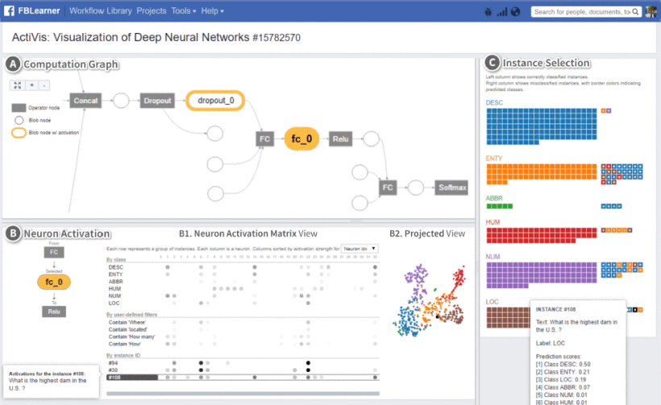
ActiVis
A: 总结了模型架构。B: 神经元激活面板的矩阵视图显示实例，子集，和类的激活情况（B1），还有投影视图所示实例激活的2D TSNE投影（B2）。C: 实例选择面板显示实例和它们的分类结果; 左侧显示正确分类的实例，右侧显示错误分类的实例。单击一个实例会将其添加到神经元激活矩阵视图。
The dataset : public TREC question answering data collections.
The trained model : a word-level convolutional model.

Slide 14
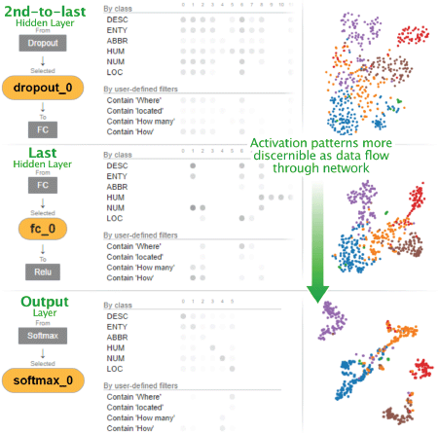
Interface: Tight Integration of Model, Instances, and Activation Visualization
A: Overview of Model Architecture
Deep neural network models are often represented as computation graphs (DAGs) . Understand the structure of the models and find interesting layers to explore the detailed activations.
B: Activation for Selected Node
Select multiple nodes and visually compare their activation patterns. Fig. illustrates that users can visually explore how models learned the hidden structure of data through multiple layers.
C: Instance Selection
Get an overview of instances with their prediction results and determine which ones should be added to the neuron activation view for further exploration and comparison.

Slide 15
Future Work
Visualizing Gradients
Gradients would help developers to locate neurons or datasets where the models do not perform well.
Real-Time Subset Definition
Integrate dynamic filtering and searching capabilities, to speed up both subset definition and instance selection.
Automatic Discovery of Interesting Subsets
ActiVis could help suggest interesting subsets for exploration, based on heuristics or measures.
Supporting Input-Dependent Models
Extend ActiVis to support models that contain variable nodes whose number of neurons changes depending on the input, and to study the relationships between neurons and subsets for such cases.
Understanding How ActiVis Informs Model Training
Such as how ActiVis may inform the model training process. For example, hyperparameter tuning.

Slide 16
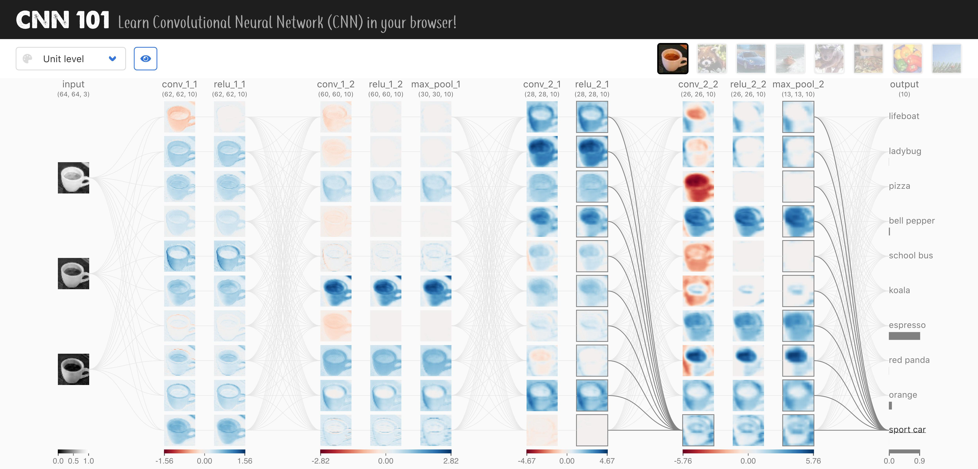
CNN101 向初学者解释CNN如何在不同抽象级别上工作，同时帮助用户在这些级别之间流畅地转换，以获得更全面的理解。
1. 它集成了一个更实用的模型和数据集，供学习者探索。传统上，部署深度学习模型需要大量计算资源，例如，具有强大硬件的服务器。然而，即使使用专用的后端服务器，也很难支持大量并发用户。相反，CNN 101是使用现代网络技术开发的，所有结果都直接在用户的网络浏览器中计算。
2. 新颖的交互式可视化设计，它采用了overview+detail、interaction和animation，同时总结了复杂的模型结构，并为用户提供上下文来解释详细的数学运算。
CNN101，一个交互式可视化系统解释和教学卷积神经网络。通过紧密集成的交互视图，提供了模型如何工作的概述和详细描述。

Slide 17
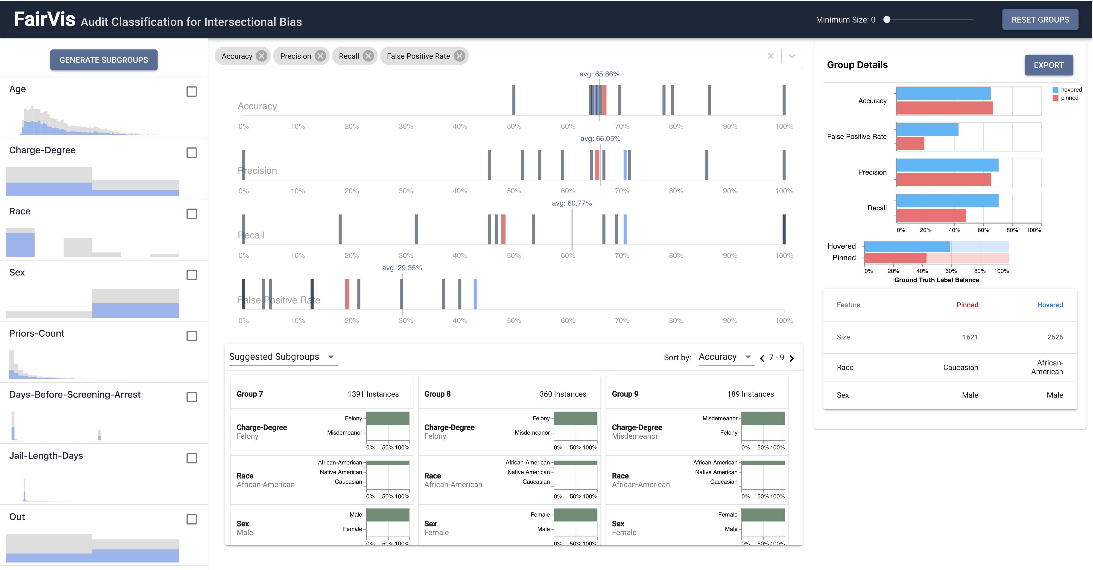
FairVis 由于公平性的定义众多，且存在大量潜在的受影响子群，因此发现机器学习模型引入的偏差是一个巨大的挑战。
我们提出了一个混合主动视觉分析系统FAIRVIS，它集成了一种新的子组发现技术，供用户审计机器学习模型的公平性。通过FAIRVIS，用户可以应用领域知识生成和研究已知的子群，并探索建议的和相似的子群。协调视图使用户能够探索子组性能的高级概述，并随后深入到特定子组的详细调查中。
Fairvis, 一个发现机器学习偏差的可视化分析系统，演示了交互式可视化如何帮助数据科学家和公众理解和创建更公平的算法系统。

Slide 18
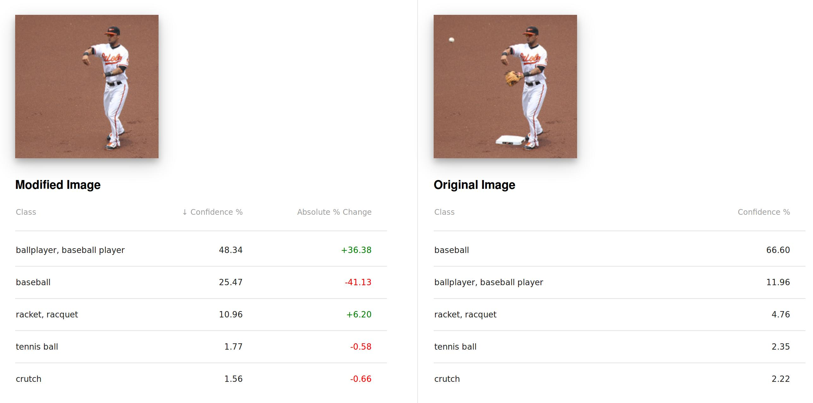
Interactive Classification 交互数据可视化揭示了模型如何使用交互对话学习和行为，而不是静态解释。
我们提出一个互动系统，让使用者可以操控影像，以探讨深度学习影像分类器的稳健性和灵敏度。利用现代网络技术进行浏览器内推理，用户可以使用修复算法去除图像特征，并实时获得新的分类，这使得他们可以通过实验修改图像并查看模型的反应，提出各种“假设”问题。

Slide 19
Thanks！

